Slide 1

The IMPACT OF MEMBERSHIP STATUS ON CYCLISTIC BIKE USAGE
August 2022
Connor Vaccaro

Slide 2
GOALS OF THIS CASE STUDY
1
Examine daily and hourly ridership trends by member group
We will explore how different users ride bikes through the week and what that means about Cyclistic users
2
Examine monthly ridership trends by member group
Understanding monthly usage will help Cyclistic run specific campaigns to target membership groups
3
Explore some potential next steps for your business
We will look at the key takeaways from the data to see how we can make improvements in ridership for Cyclistic

Slide 3
ABOUT THE DATA
Collected from all rides by Cyclistic users in 2021
Contains a timestamp of when the trip started and ended
Grouped by membership status
(casual = non-member)
Assumed that all rides with <= 0 duration were errors

Slide 4
Topic ONE
Examine daily and hourly ridership trends by member group

Slide 5
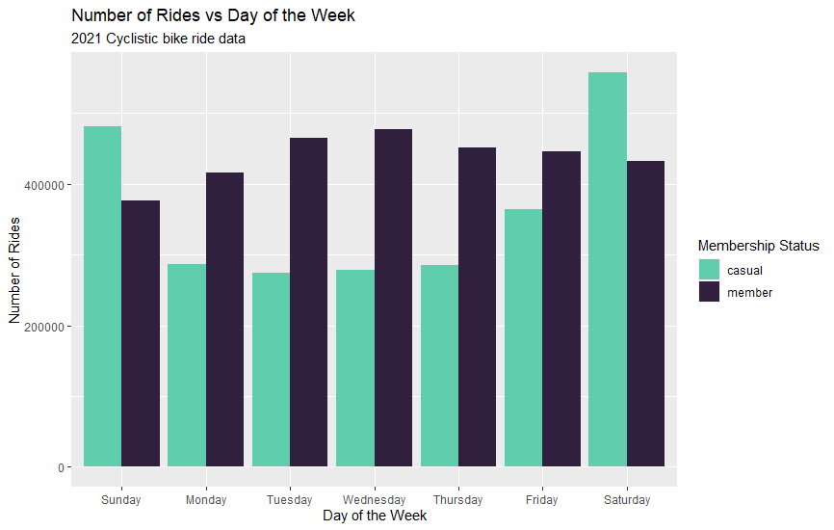
NUMBER OF RIDES VS DAY OF THE WEEK
Key takeaways
By analyzing the past year of ride data, we can see consistent trends in how users ride bikes throughout the week
Member bike usage is highest during the week
Non-members bike usage is significantly higher during the weekend

Slide 6
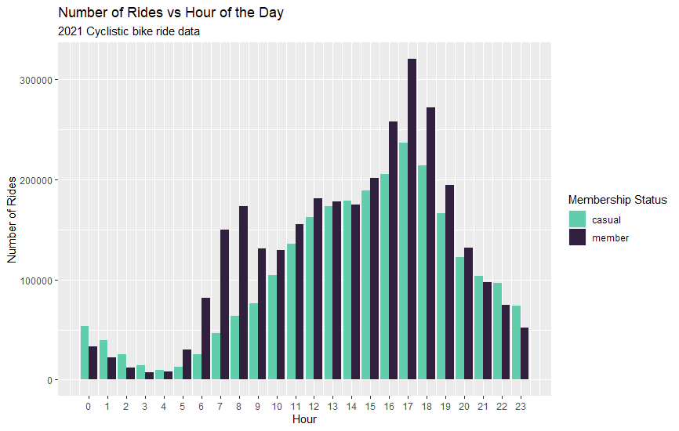
NUMBER OF RIDES VS HOUR OF THE DAY
Key takeaways
Member bike usage is highest in the morning and afternoon, indicating they use the bikes to commute to and from work
Non-members bike usage is low in the morning, then peaks in the afternoon

Slide 7
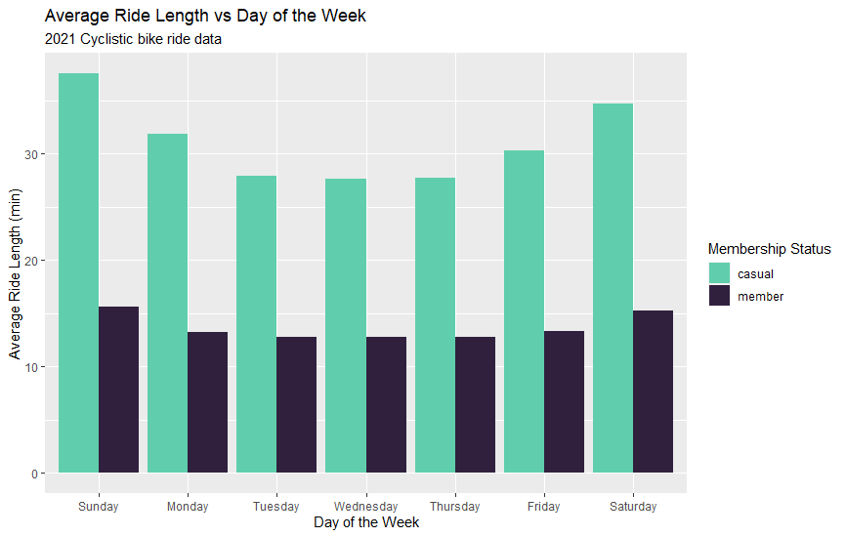
RIDE LENGTH VS DAY OF THE WEEK
Key takeaways
By analyzing the past year of ride data, we can see consistent trends in how users ride bikes throughout the week
Average ride length increases during the weekend
Non-members ride for approximately twice as long as members

Slide 8
Topic TWO
Examine monthly ridership trends by member group

Slide 9
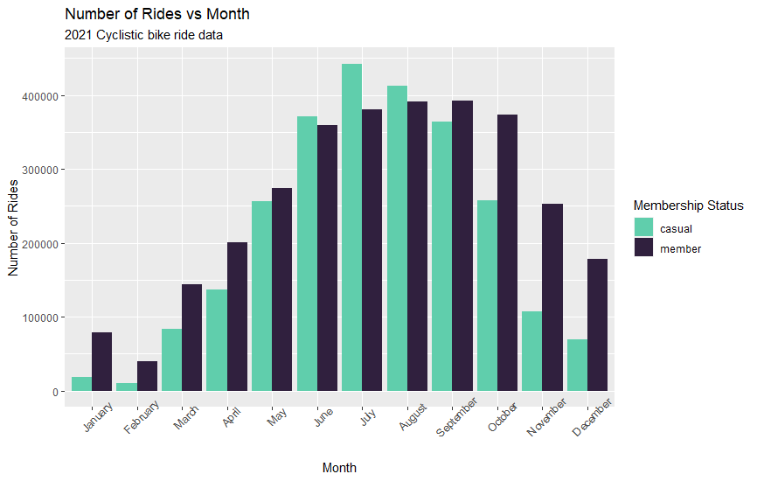
NUMBER OF RIDES VS MONTH
Key takeaways
By analyzing the past year of ride data, we can see consistent seasonal trends in how users ride bikes
Ridership is highest during the summer for both membership groups
Non-members bike usage drops significantly during the fall and winter
Members bike usage is steady into the fall, but drops off during winter

Slide 10
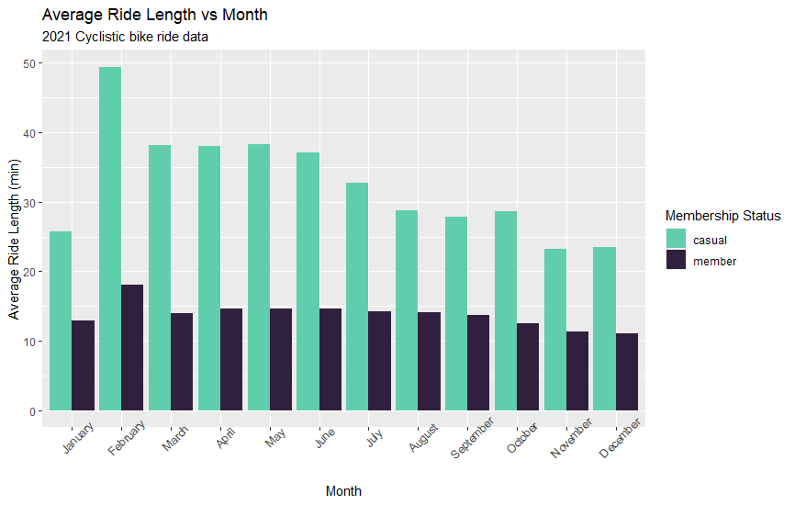
RIDE LENGTH VS MONTH
Key takeaways
Like we saw in the weekly data non-members ride for significantly longer periods than members
Average ride length is highest during the late winter/spring
Average ride length is lowest during the fall/winter

Slide 11
Topic THREE
Explore some potential next steps for the business

Slide 12
NEXT STEPS FOR CYCLISTIC
Account for low ridership during the offseason
Ridership for non-members is lowest during the fall and winter. Running a promotion for discounted casual fares during these months could help drive bike usage.
Increase casual to member conversion by adding commuter or weekend membership tiers
Offering new membership tiers could help drive casual users to sign up for memberships. Adding a “Weekend Warrior” tier for people that only use the bikes during the weekend, and a “Commuter” tier for people only using the bikes to get to and from work could help drive sign ups.
Increase member usage throughout the year by adding rewards/achievement program
Members' metrics such as daily/weekly usage and streaks could be used to design a rewards or achievement system that could help drive bike usage during the off season.

Slide 13
Thank you
Connor Vaccaro
cbvaccaro@gmail.com
connorvaccaro.github.io

